Slide 1
Status of the OceanSITES Network Champika GALLAGE DBCP Coordinator/ OceanSITES Project Office cgallage@jcommops.org OceanSITES 2016 11th Steering Committee and 8th Data Management Team Meeting
National Oceanography Centre, Southampton, United Kingdom 25 - 29 April 2016

Slide 2
Status of the Network
Status based on the information received until January 2016
Some adjustments made based on the comparison between mater sheet and DGAC information
Status of some platforms yet to be clarified (i.e. SOTS – PULSE, PULSE-HEAVY, SOFSMET ?? , Only available SOTS platform on GDAC is SOTS)
Total 332 platforms on Master list
Following platforms are on GDAC ,
no metadata provided to the Master sheet
SITE | PLATFORM
ANTARES | ANTARES-1
ESTOC | ESTOC-2
ESTOC | ESTOC-C
P12N23W | P12N23W
R0N67E | R0N67E
R1.5N67E | R1.5N67E
SOTS | SOTS
Notes:
Here, all the information I am going to show you is based on the information I received from you. During last year and half, I have requested updates from PIs to the platform metadata information which we call master sheet number of times. Many of you have responded to my requests and I updated the information accordingly.
I also spend time to cross check the GDAC information to verify some of this information you provided and made adjustments.
Once I crosscheck the master data with GDAC I found number of mismatches. I contacted the PIs of those platforms individually to resolve those issues, majority of those discrepancies were clarified but some are yet to be resolved. One example is SOTS site. In Master sheet there are 4 different platforms listed with metadata. But on GDAC there is only one platform. Until I receive confirmation from the PI I cannot change anything on the master sheet.
Including those 3 platforms, we have 332 platforms registered in OceanSITES that comes from 304 different sites.
We still need to clarify some file naming issues for FRAM sites.
7 platforms are on GDAC but no metadata available on the master sheet. I contacted the PIS for these sites individually but have not received any response yet.

Slide 3
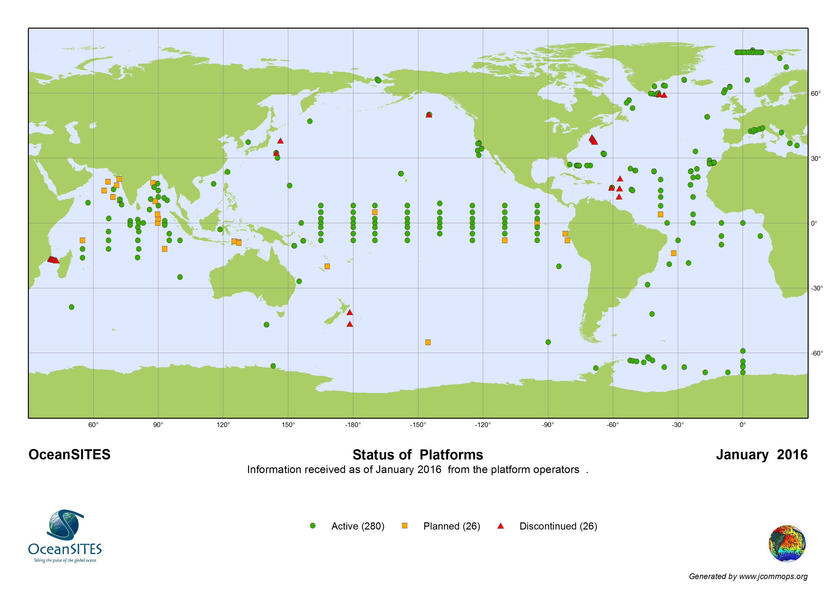
Network Status
Notes:
There are 332 platforms registered in OceanSITES master sheet. 280 are active platforms, 26 are planned and 26 are discontinued.

Slide 4
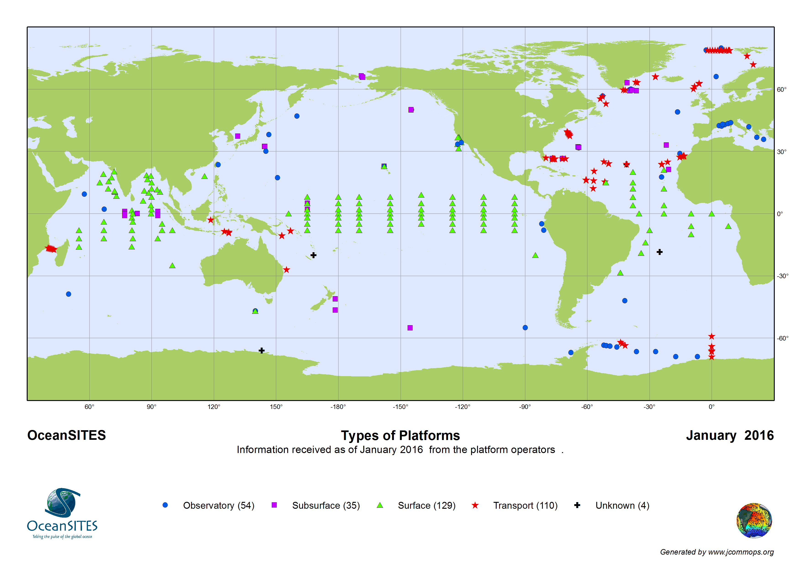
Network Status
Notes:
When we focus on the platform type, Here we consider 4 different platform types Observatories are blue dots. There are 54 of them. 35 Subsurface stations, 129 Surface moorings and 110 Transport sites.
Unknown sites
IMOS-POLYNYA from Polynya array in the pacific Ocean (Australia - CSIRO)
NOG-1 sitein Atlantic ocean (UK - NOC)
SOG-1 site in Atlantic Ocean (UK - NOC)
SPOT mooring in Pacific (France –IRD)

Slide 5
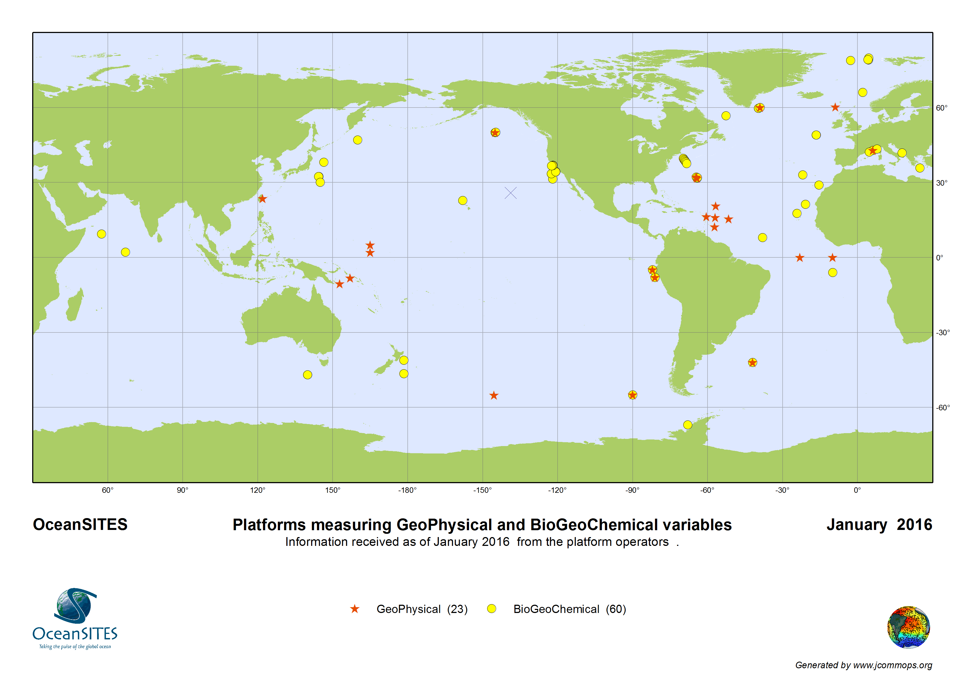
Network Status
Notes:
Out of the 332 platforms 23 are providing data on Geophysical measurements. 60 are providing BioGeoChemical parameters.

Slide 6
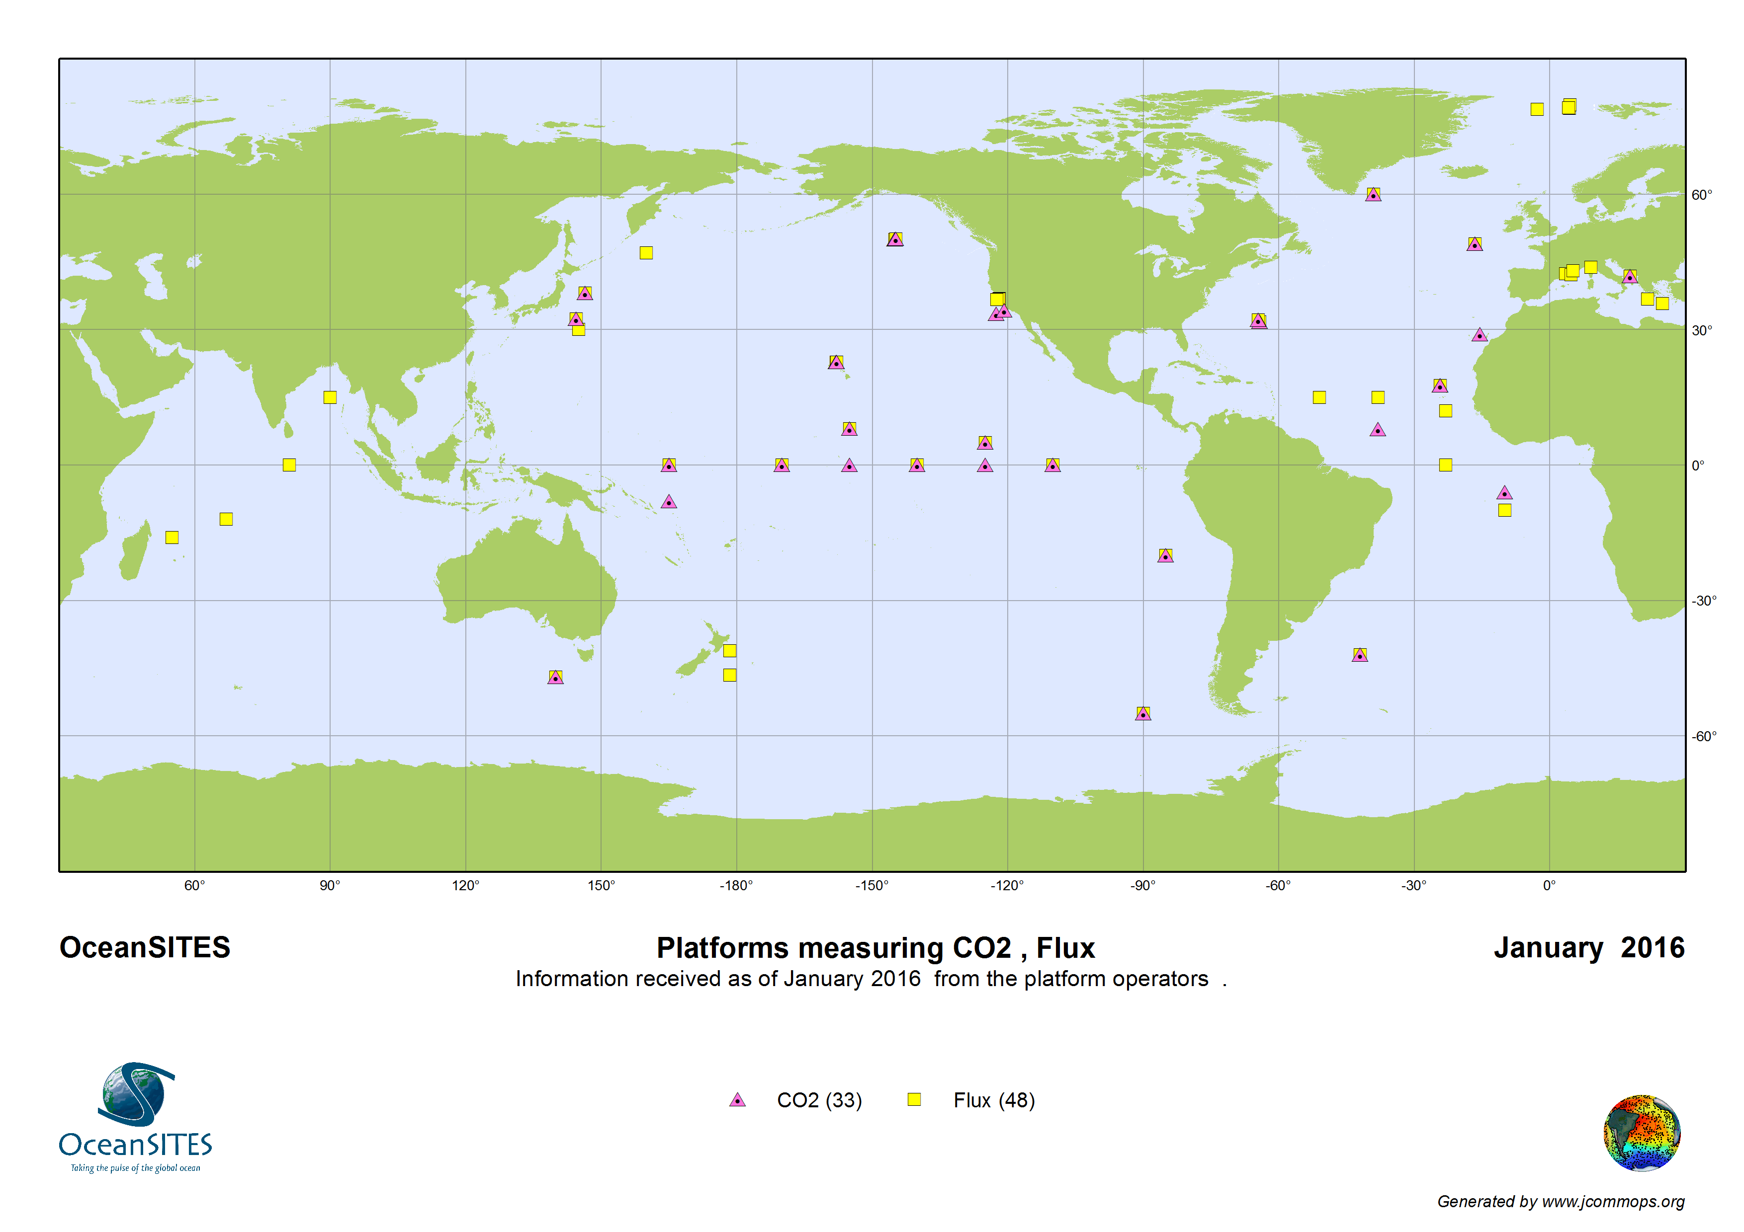
Network Status
Notes:
Here we have the platforms measuring co2 and air sea Fluxe

Slide 7
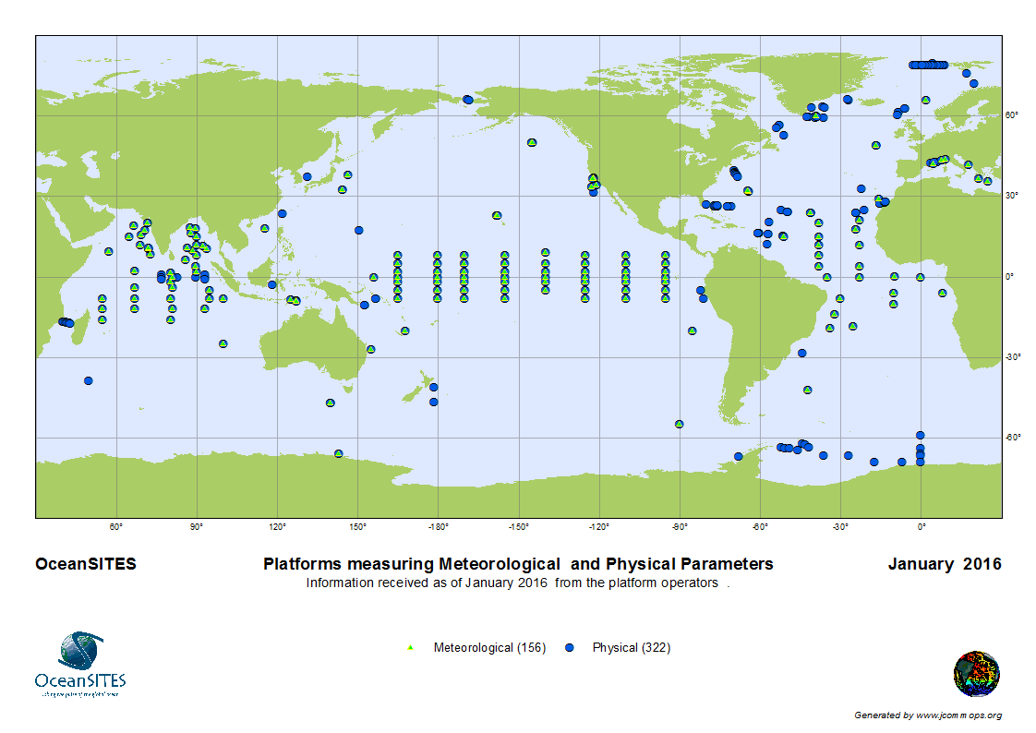
Network Status
Notes:
Here we have the platforms measuring Meteorological and physical parameters.

Slide 8
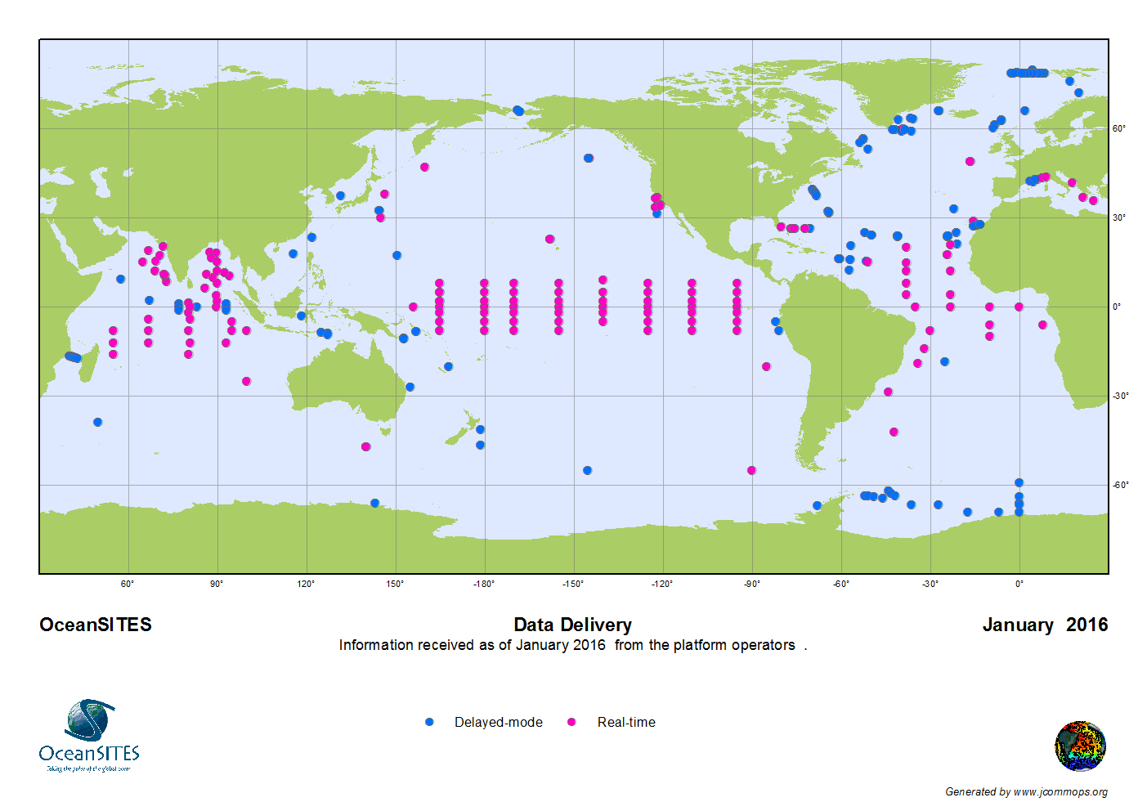
Network Status
Notes:
In Data Delivery 172 platforms deliver data in delayed mode and 160 provide data in real time to the GTS. This is based on the information you provided.

Slide 9
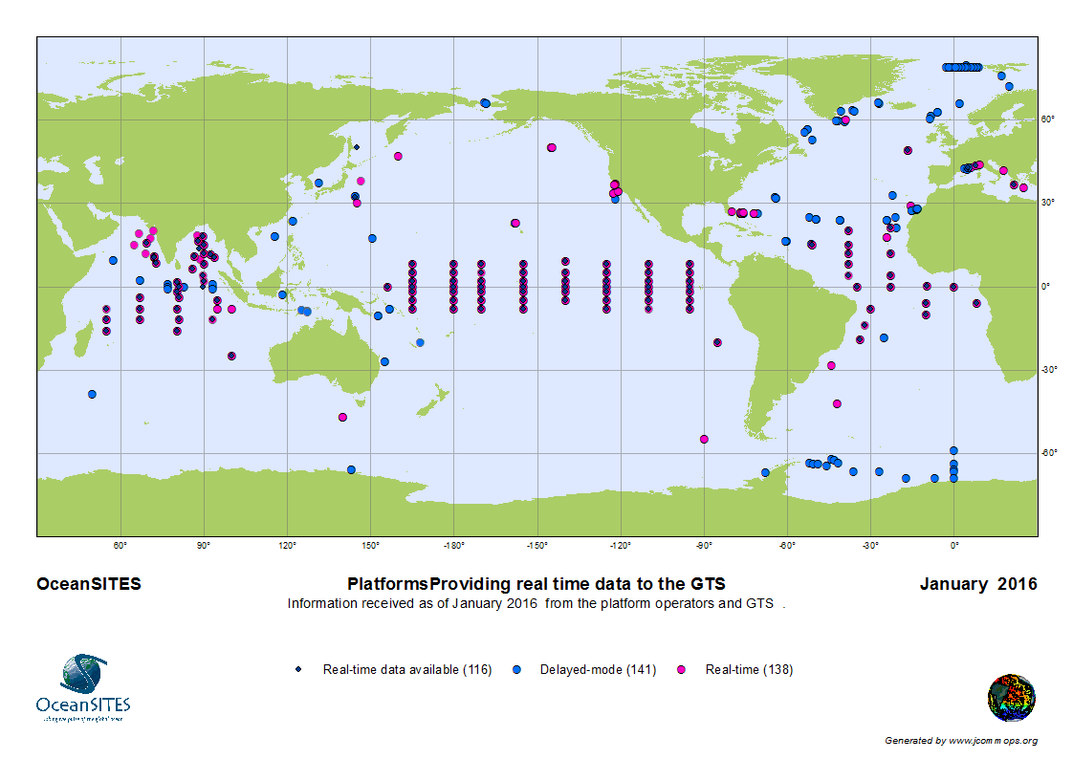
Network Status
Notes:
Then I did a search to see which platforms are providing data to the GTS.
Here I have mapped all active platforms with their data delivery status , real time and delayed more. Then I overlay the platforms which are or have provided data to the GTS, there are only 116 platforms providing data to the GTS in reality.
But 138 platforms are reported as real-time data providers.

Slide 10
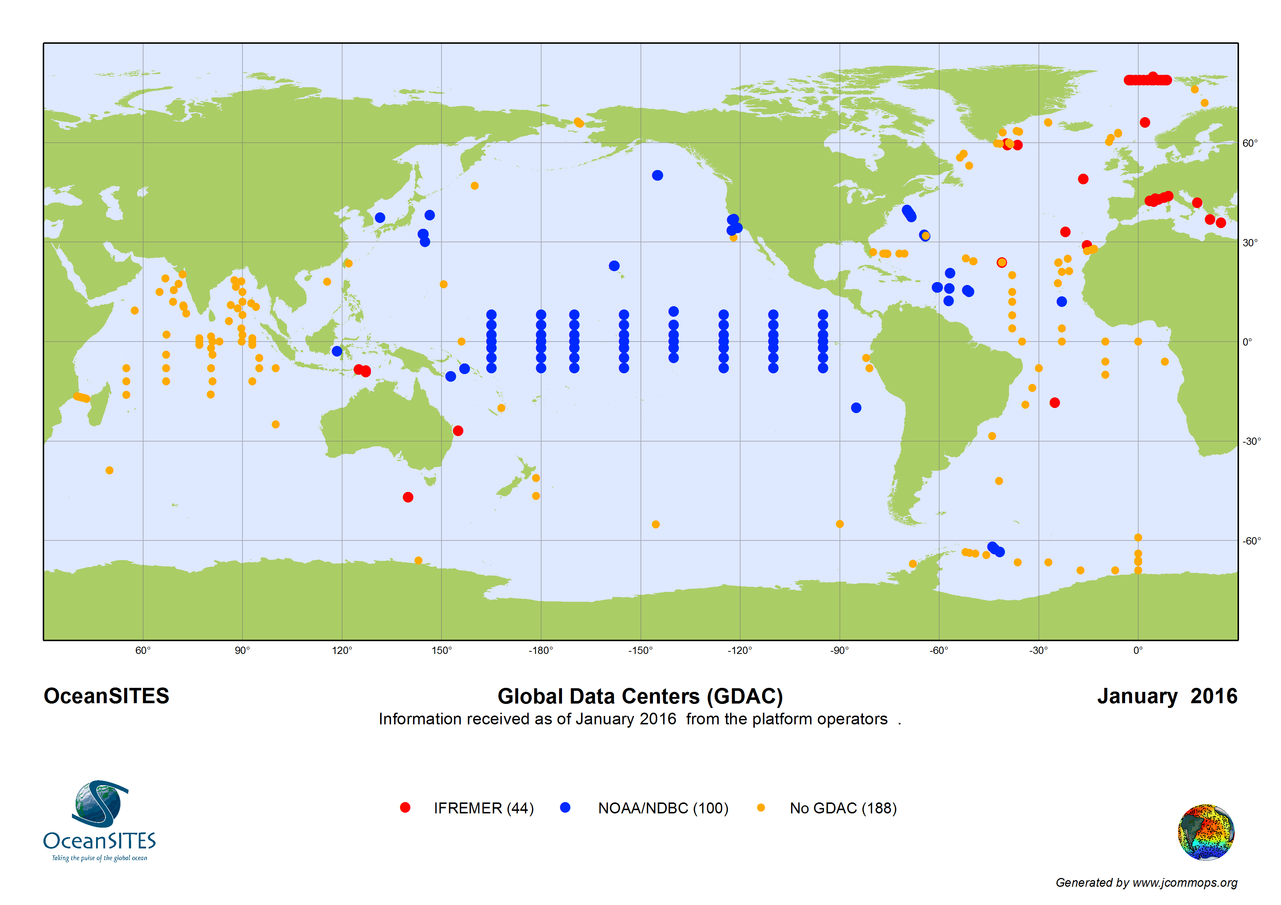
Network Status
Notes:
Data submission to GDACS are mapped here blue are the ones sending data to NDBC, red dots are the data providers to Ifremer GDAC and others are in DACS

Slide 11
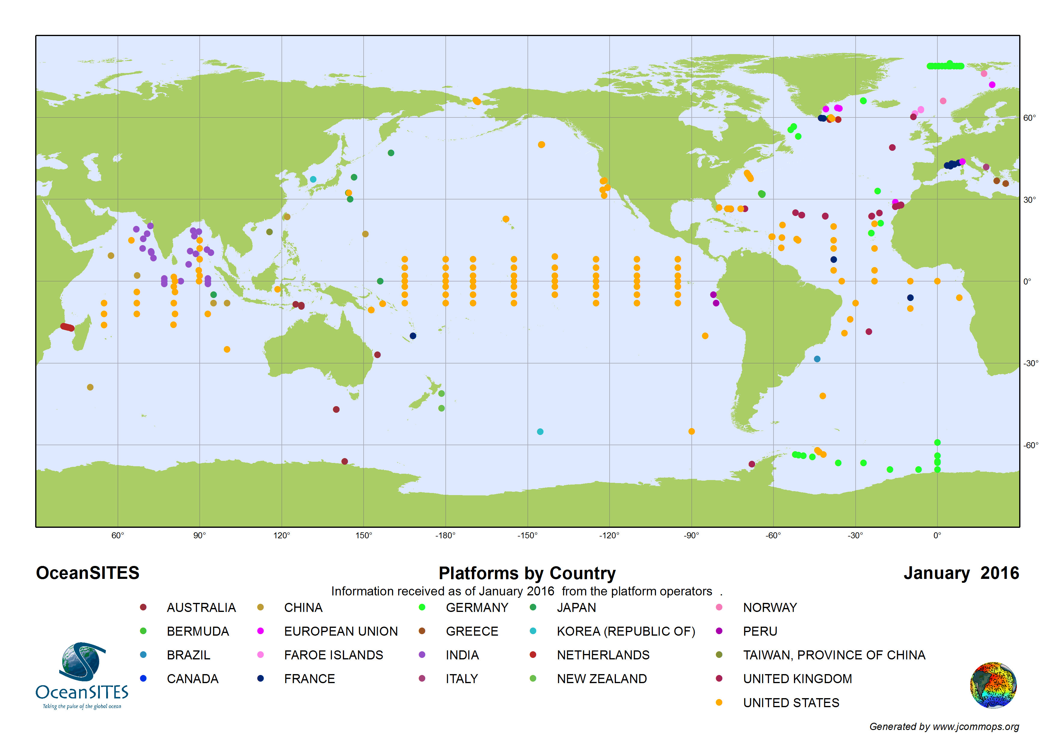
Network Status
Notes:
21 countries contributing to the OceanSITES program

Slide 12
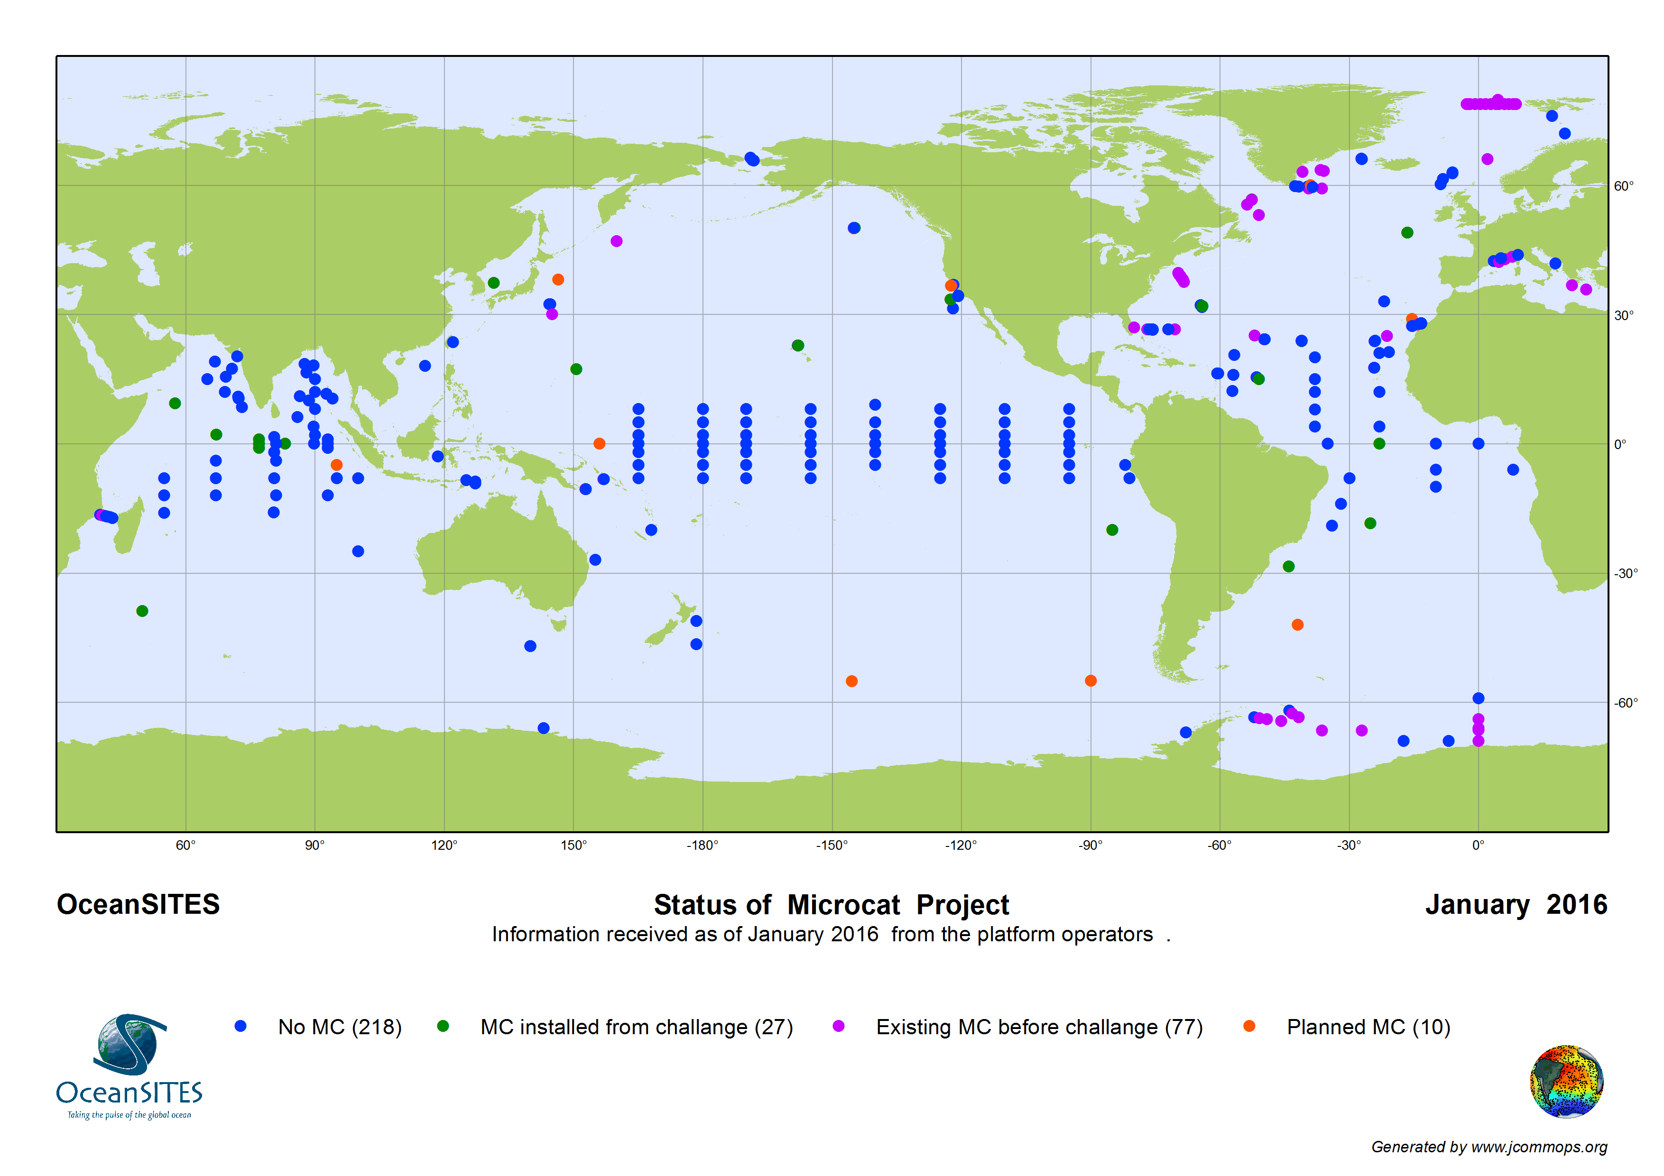
Status of Microcat Project
Notes:
There has not been many changes in microcat project. This shows the status of the microcat project. 218 platforms are not carrying MC sensors and identified in blue dots. Purple dots represent the microcats existed before the challenge. There are 27 sensors installed from the MC challenge project 10 are planned.

Slide 13
Summary
Notify Project Office on changes to the Stations/platforms
Submit updated white papers on site information to Project Office
Follow DMT guidelines when submitting data to the GDACs
Timely response to emails/requests from Project Office
Thank you !
Notes:
Notify Project Office on changes to the Stations/platforms , you also can make the changes to the platforms and enter new platform information through new JCOMMOPS web application . We will talk more about it in coming days.
Submit updated white papers on site information to Project Office. All white papers submitted to project office are available in Google docs
Recently I spend much time mapping the Metadata information you provided with the GDAC information. This was done in order integrate the OceanSITES information into new JCOMMOPS web application. There were many instances where the data submission rules have not been followed. For an example CF standard names. I will talk more about it in DMT meeting.
So I request you to strickly Follow DMT guidelines when submitting data to the GDACs
Timely response to emails/requests from Project Office

